Slide 1
ECHOCARDIOGRAPHIC EVALUATION OF PULMONARY ARTERY PRESSURE

Slide 2
INTRODUCTION
Definition:
Pulmonary hypertension - hemodynamic and pathophysiological condition defined as increase in mean PAP ≥ 25 mm Hg at rest assessed by right heart catheterisation.
GRADE | MPAP
MILD | 25-40
MODERATE | 41-55
SEVERE | >55
2015 ESC/ERS Guidelines for the diagnosis and treatment of pulmonary hypertension
Notes:
normal PAPm at rest is 14 ± 3 mmHg with an upper limit of normal of approximately 20 mmHg.^{1,2} The clinical significance of a PAPm between 21 and 24 mmHg is unclear.

Slide 3
Definition | characteristics | Clinical group
Pulmonary hypertension | PAPm ≥ 25 mmHg | All
Pre-capillary PH | PAPm ≥ 25 mm Hg PAWP ≤ 15 mm Hg | Pulmonary arterial hypertension 3. PH due to lung diseases 4. Chronic thromboembolic PH 5. PH with unclear and/or multifactorial mechanism
Post-capillary PH | PAPm ≥ 25 mm Hg PAWP >15 mm Hg | PH due to left heart disease 5. PH with unclear and/or multifactorial etiology
Isolated postcapillary PH | DPG <7 mm Hg and/or PVR ≤ 3 WU
Combined pre and postcapillary PH | DPG ≥ 7 mm Hg and /or PVR > 3 WU
Notes:
However, the previous definition of PH-LHD and the associated terminology of “passive” and “reactive” or “out-of-proportion” PH-LHD have been unsatisfactory for the characterisation of patients. Transpulmonary pressure gradient (TPG) is sensitive to changes in cardiac output, recruitment and distension of pulmonary vessels decreasing upstream transmission of left atrial pressure. Furthermore, pulmonary blood flow is pulsatile with systolic PAP and mean PAP, determined by stroke volume and arterial compliance [3–5]. At the fifth World Symposium on Pulmonary Hypertension in Nice, France, in 2013 and in the recently published ESC/ERS guidelines for the diagnosis and treatment of PH, the definition of PH-LHD was revised [1, 2, 5], mainly based on the observations that DPG is less flow dependent and less sensitive to elevation of left atrial pressure than TPG [4], and reflects pulmonary vascular remodelling

Slide 4
Clinical classification of pulmonary hypertension
1. Pulmonary arterial hypertension
2. Pulmonary artery due to left heart disease
3. Pulmonary hypertension due to lung diseases and/or hypoxia
4. Chronic thromboembolic pulmonary hypertension and other pulmonary artery obstructions
5. Pulmonary hypertension with unclear and /or multifactorial mechanisms
Group 1. PULMONARY ARTERIAL HYPERTENSION
Idiopathic
Heritable
Drugs and toxins induced
Associated with : CTD, HIV, portal hypertension, CHD, schistosomiasis
I’ : pulmonary veno-occlusive disease and/or pulmonary capillary hemnagiomatosis
I” : persistent pulmonary hypertension of the newborn
GROUP 2: PULMONARY HYPERTENSION DUE TO LEFT HEART DISEASE
1. Left ventricular systolic dysfunction
2. Left ventricular diastolic dysfunction
3. Valvular disease
4. congenital/ acquired left heart inflow/outflow tract obstruction and congenital cardiomyopathies
5. congenital/acquired pulmonary vein stensois
GROUP 3. PULMONARY HYPERTENSION DUE TO LUNG DISEASES AND/OR HYPOXIA
COPD
2. ILD
3. Other pulmonary disease with mixed restrictive and obstructive pattern
4. sleep- disordered breathing
5. Aleveolar hypoventillation disorder
6. Chronic exposure to high altitude
7. Developmental lung disease
GROUP 4. CTPH AND OTHER PULMONARY ARTERIAL OBSTRUCTION
CTPH
2. 1 – angiosarcoma
2.2 – other intravascular tumors
2.3 – arteritis
2.4 – congenital pulmonary artery stenosis
2.5 – parasite (hydatiodsis)
GROUP 5. PH WITH UNCLEAR AND/OR MULTIFACTORIAL MECHANISM
1. Hematological disorders- hemolytic anemia, MPD, splenectomy
2. Systemic disorders: sarcoidosis, pulmonary histiocytosis, lymphangioleiomyomatosis, neurofibromatosis
3. Metabolic disorders: GSD, Gaucher disease, thyroid disorders
4. other: pulmonary tumoral thrombotic microangiopathy, fibrosing mediastinitis, chronic renal failure, segmental pulmonary hypertension

Slide 5
EVALUATION
Clinical features and examination
ECG, CXR, ABG, PFT
Non- invasive imaging –
Most important screening tool - TTE

Slide 6
TTE in estimation of pulmonary artery pressure
Non-invasive widely available tool for diagnosis of PH
Comparing with gold standard – RHC- echo has sensitivity of ≈ 90% and specificity of 70% in diagnosis of PH
Can assess contribution of LV systolic and diastolic dysfunction, valve function and congenital lesions
Quantitate PA pressures
prognosis

Slide 7
RV ANATOMY AND PATHOPHYSIOLOGY
Anteriorly situated cardiac structure- retrosternal
More triangular in shape and curves over the LV
In cross-section – crescentic
curvature of the ventricular septum places the RV outflow tract antero-cephalad to that of the LV - "cross-over" relationship between right and LV outflows

Slide 8
Irregular shape and heavy trabeculation
Retrosternal position of the RV
Echo assessment difficult

Slide 9
Pulmonary vascular bed is a low-resistance system in healthy individuals
RV is more compliant than the LV and adapts better to volume loading than pressure loading
ventricular interdependence (mediated by the interventricular septum)
Notes:
Ventricular septal geometry and motion are largely determined by the difference in pressure across the ventricular septum. Under normal circumstances, the higher pressures in the LV cavity mean the IVS bows into the lower pressure RV cavity. In patients with PH, pressure in the RV increases causing the septum to flatten in systole as the pressures in both ventricles begin to converge. Eventually, when the RV becomes severely pressure loaded, the septum may even bulge into the LV cavity (fig. 1) [4]. These changes also impact on both LV systolic and diastolic function.

Slide 10
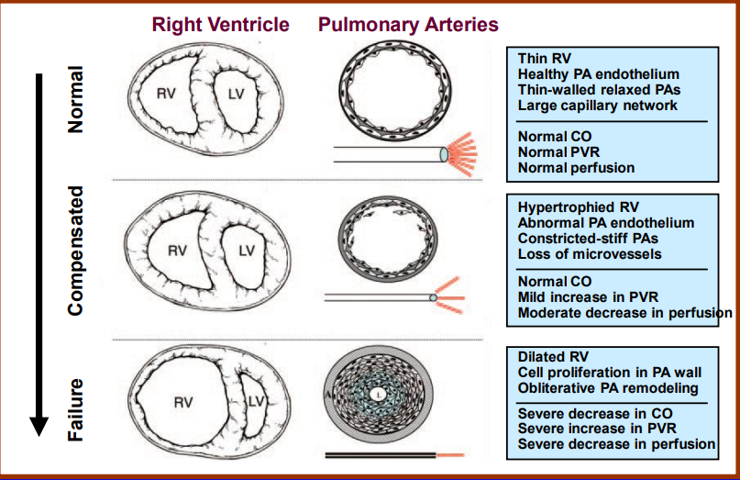
ventricular remodelling- a result of chronic progressive pressure loading

Slide 11
RV dilatation leads to tricuspid annular dilatation – significant tricuspid regurgitation
Additional volume overloading – impair diastolic function – increase RVEDP – displace IVS
Notes:
Right ventricular dilation also leads to tricuspid annular dilation and results in significant tricuspid regurgitation [4]. When this is coupled with decreased RV systolic dysfunction and increased afterload it will further reduce stroke volume into the pulmonary circulation and resultant reduced cardiac output. The additional volume loading as a consequence of tricuspid regurgitation will further impair RV diastolic function, increasing RV end-diastolic pressure and displacing the IVS.

Slide 12
2 d echocardiographic signs In ph

Slide 13
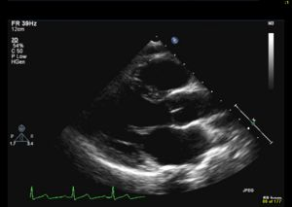
Right heart imaging
Parasternal long axis view:
- triangular echo- free structure
mass of RV is less than one sixth and its diameter less than one third of the LV
In PH, RV free wall is hypertrophied and cavity may be dilated
Notes:
normal subjects the anterior RV wall is thin

Slide 14
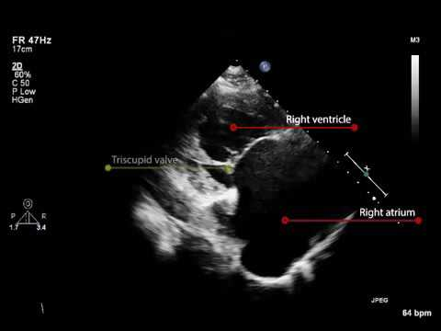
Parasternal long axis view of the RV inflow:
In PH, RV apex is hypertrophied and the cavity is dilated
Basal diameter of RV – 3.7-5.4 cm
tricuspid annulus diameter
Assess tricuspid valve apparatus

Slide 15
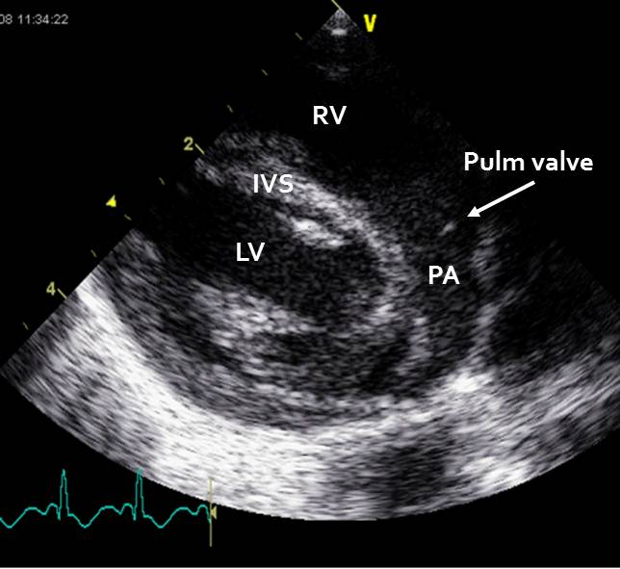
Parasternal long axis view of the RV outflow:
- normal RV outflow tract dimension: 1.7-2.3 cm in diastole
Pulmonary artery will be dilated
Normal measurements: MPA : 1.5-2.1
RPA : 0.7-1.7
LPA : 0.6-1.4

Slide 16
Parasternal short axis view:
D-shaped LV cavity
In volume overload situations: Septal bulge occurs in diastole
In pressure overload conditions: occurs in systole ± diastole

Slide 17
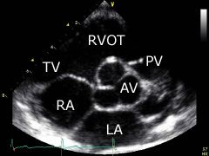
PSAX at RV basal level
PSAX at PA bifurcation
RVOT dimension in diastole
TR jet parameters can be assessed if TR jet parallel to the US beam
Assess pulmonary valve, PA and branches
Measuring pulmonary annulus diameter, PA size, Doppler measurement of infundibulum, PV and PA
Distal RVOT measurement

Slide 18
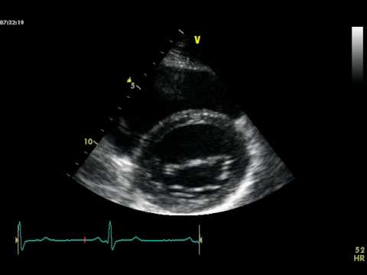
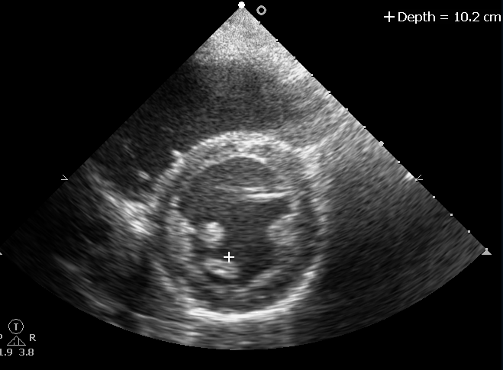
Crescent shape of RV
Septal flattening during systole & diastole

Slide 19
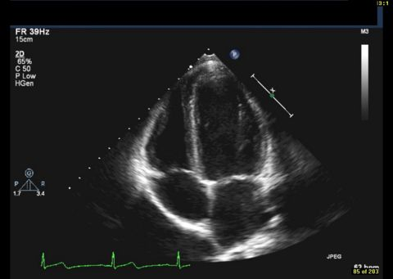
Apical 4 chamber view:
RV hypertrophy, dilatation
RV free wall is the first to become hypertrophied : systolic dysfunction and lower tissue myocardial velocities
apex is frequently hypertrophied and akinetic
Notes:
the RV appears triangular in shape and about the one-third the size of the LV. The apex of the RV is located closer to the base of the heart than that of the LV.

Slide 20
Indirect 2D echo signs in PH
RV wall thickness
> 5mm
Measure of RVH, usually secondary to increased RVSP
Measured at end-diastole
M-mode/ 2D echo
Subcostal window- at the level of tip of anterior tricuspid leaflet
Left parasternal window
Exclude trabeculation, papillary muscle and epicardial fat

Slide 21
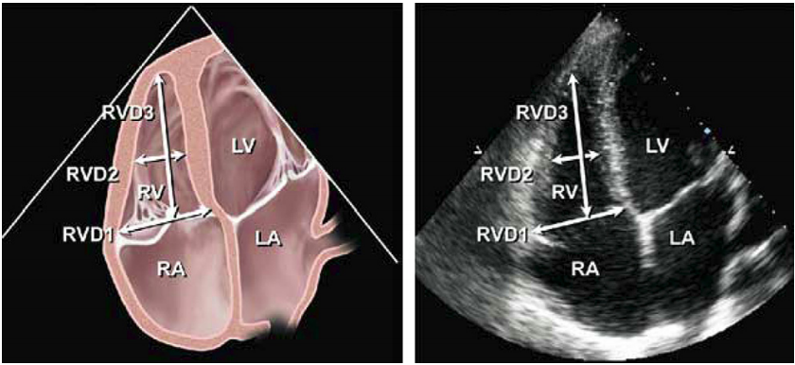
2. RV dilation :
level | Diameter
Base | >42 mm
Mid level | >35mm
Longitudinal | >86mm
RV focused apical 4 chamber view
Notes:
Recommendations: Patients with echocardiographic evidence of right-sided heart disease or PH should ideally have measurements of RV basal, mid cavity, and longitudinal dimensions on a 4-chamber view. In all complete echocardiographic studies, the RV basal measurement should be reported, and the report should state the window from which the measurement was performed (ideally the right ventricle–focused view), to permit interstudy comparison

Slide 22
3. RVOT dilation
Best viewed from the left parasternal and subcostal view.
RVOT distal diameter, just below pulmonary valve- most reproducible
PSAX- distal RVOT diameter >27mm is RVOT dilation
Pitfalls: -oblique imaging – under/overestimate the size
-cant be used in those with chest and spine deformity

Slide 23
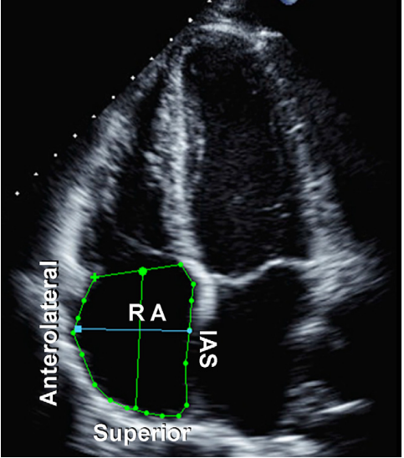
4. RA dilation
Estimated from A4C
upper limit for:
Major axis dimension-53mm
Minor axis dimension- 44mm
- RA area (end- ventricular systole) 18 cm²
Notes:
RA area is traced at the end of ventricular systole (largest volume) from the lateral aspect of the tricuspid annulus to the septal aspect, excluding the area between the leaflets and annulus, following the RA endocardium, excluding the IVC and superior vena cava and RA appendage (Figure 3).5 Note that RA dimensions can be distorted and falsely enlarged in patients with chest and thoracic spine deformities.
Because of the paucity of standardized RA volume data by 2D echocardiography, routine RA volume measurements are not currently recommended.

Slide 24
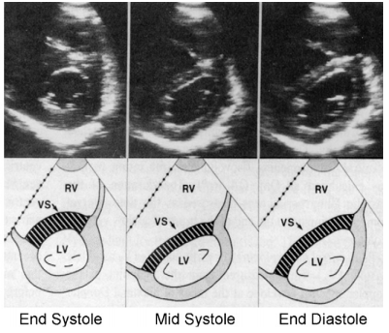
5. LV eccentricity index:
the degree of distortion of the LV and IVS arising due to increased pressure in the RV during diastole and systole ; can be quantified using a short-axis view at the level of left ventricular papillary muscles.
PRESSURE OVERLOAD
VOLUME OVERLOAD

Slide 25
LV eccentricity index
Ratio between the LV anteroposterior dimension(D2) and the septolateral dimension(D1)
Ratio >1.0 suggest RV overload

Slide 26
II. Pressure measurements in PH

Slide 27
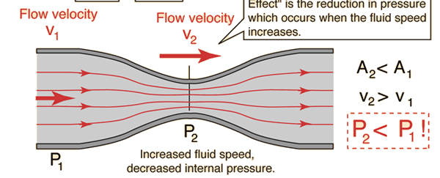
1. PASP by TR peak velocity
Continuous wave doppler of TR trace
Principle: Bernoulli’s principle
Bernoulli’s principle: conservation of energy

Slide 28
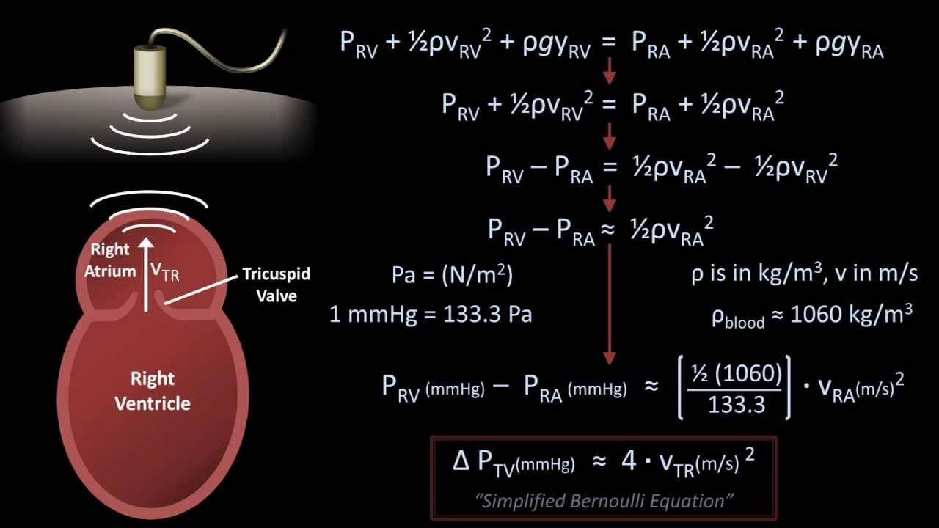

Slide 29
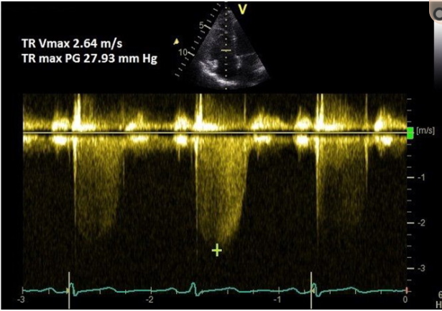
Views: parasternal long axis (RV inflow)
parasternal short axis
apical 4 chamber view
Co-axial TR jet to be identified
Notes:
A coaxial TR jet is identified in parasternal long axis (RV inflow), parasternal short axis, or apical 4-chamber view with the help of colour Doppler.

Slide 31
RVSP = 4V² + RAP
Assessing RA pressure:
Secondary measures of RA pressure:
Restrictive filling – tricuspid E/A >2.1, with deceleration time <120 ms
Tricuspid E/E’>6
Diastolic flow predominance in hepatic vein (systolic filling fraction <55%)
Parameters | 0-5 mm Hg (3mmHg) | 5-10 mm Hg (8mm Hg) |  | >15 mm Hg
IVC diameter | ≤2.1cm | ≤2.1 | >2.1 | >2.1 cm
Respiratory collapse | >50% | <50% | >50% | <50%
Notes:
recent ESC guidelines suggest just using the TRmax without additional RAP, as IVC assessment is error prone.
- If PH was defined by an SPAP in excess of 30 or 40 mm Hg, this corresponded to an MPAP in excess of 20 or 26 mm Hg. If PH was defined by an MPAP of > 25 mm Hg, this corresponded to an SPAP of > 38 mm Hg.
Hepatic vein normally has a ssytolic predominance- Vs>Vd, Vs/Vd>1. In elevated RA pressure, the Vs/Vs+Vd % is less than 55%, indicating diastolic flow predominance. It is accurate for ventillated patients, provided 5 consecutive beats are averaged.

Slide 32
The subcostal view
IVC viewed in its long axis.
The measurement is made at end-expiration
- just proximal to the junction of the hepatic veins that lie approximately 0.5 to 3.0 cm proximal to the ostium of the right atrium
In patients ventillated using positive pressure, IVC collapse cannot be used to reliably estimate RA pressure. – CVP must be used
In the same group if IVC<12mm, is suggestive of RAP <10mm Hg

Slide 33
PASP = RVSP , in the absence of pulmonary valve or RVOT gradient
mPAP = 0.61* PASP + 2mm Hg*
* Chemla D et al. New formula for predicting mean pulmonary artery pressure using systolic pulmonary artery pressure*. Chest. 2004

Slide 34
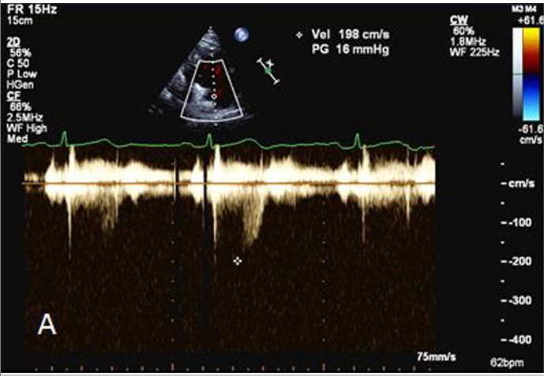
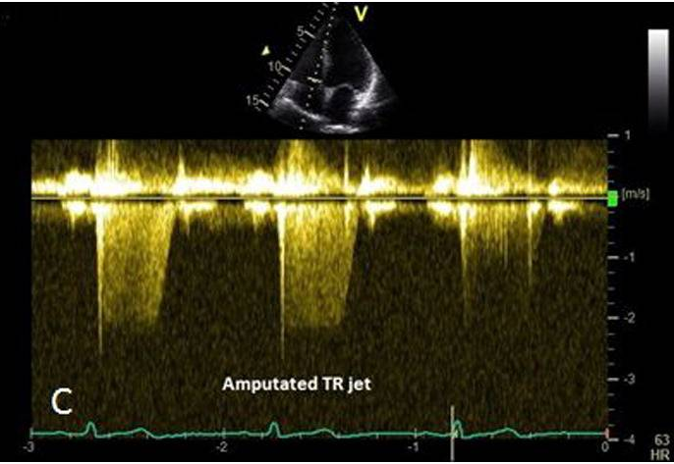
Pitfalls:
Lesser degree of TR in compensated right ventricle – underestimation of PASP
Severe TR may equalise the RA, RV pressure, cutting short the TR envelope- underestimation
In the presence of PS or RVOT obstruction
Poor TR signal
Notes:
A lesser degree of TR may occur in a compensated right ventricle (due to elevated ventricular pressure) and this could lead to underestimation of PASP. Similarly, severe TR could cause equalisation of right atrial and ventricular pressures which may cause the TR Doppler envelope to be cut short, leading to underestimation of PASP (Fig. 2-C) [8]. RAP is often overestimated if IVC measurement is used, leading to overestimation of PASP [10]. Calculations using the TR trace assume that there is no pulmonary valve stenosis and may be inaccurate in the presence of RV systolic dysfunction. TR signal could be poor in a good proportion of patients with lung disease, and TRmax measurement should be avoided in the absence of a good Doppler envelope

Slide 35
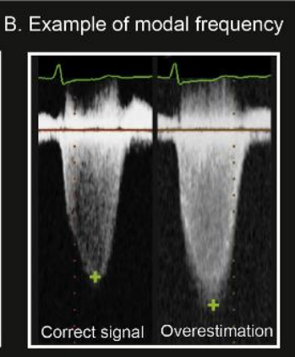

Slide 36
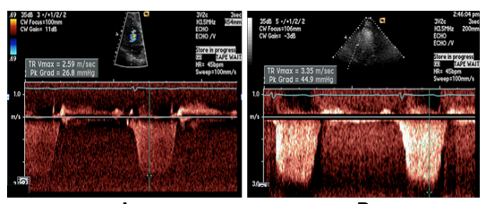
If TR signal is poor, agitated saline may be used
In case of AF, average of peak velocity of 8 cycles may be used
Resting physiological range of PASP –
a. Age
b. BMI
PASP is a flow dependent variable as the TR velocity increases.
Notes:
PASP may be as high as 40 in older >50 yrs and BMI >30kg/m2
Age related increase- more in diabetics – due to increased PA noncompliance/ abnormal LV diastolic filling pressure

Slide 37
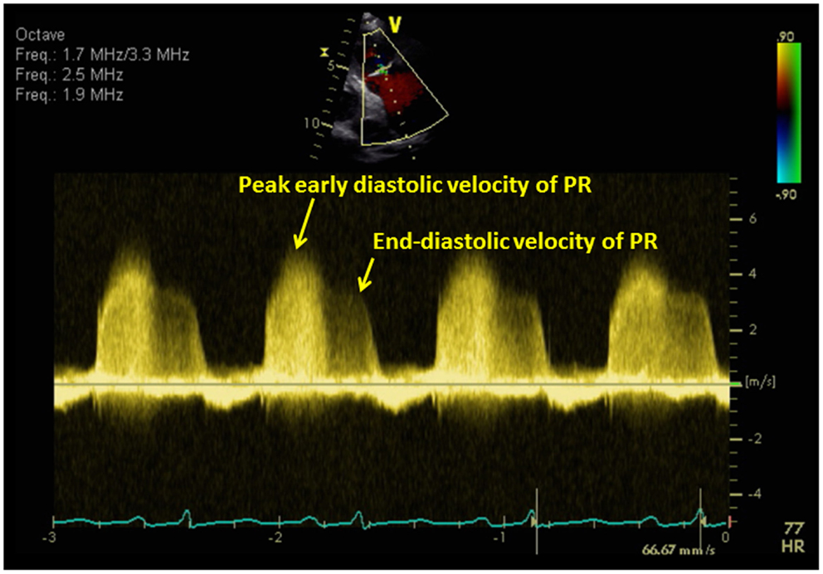
2. Evaluation of the PR signal
PR velocity reflects the pressure gradient between pulmonary artery and right ventricle during diastole.
Notes:
End diastolic velocity represents the end diastolic pressure gradient between pulmonary artery and the right ventricle. If RV EDP is added to this gradient, then we wil ge the PADP.

Slide 38
Estimation of pulmonary artery diastolic pressure from peak end-diastolic velocity
PADP = 4 (V_{PR-ED} )² + RVEDP
In the absence of tricuspid stenosis, RVEDP = RAP
PADP = 4 (V_{PR-ED} )² + RAP

Slide 39
Estimation of mPAP from peak PR velocity
Peak velocity of PR Doppler signal in early diastole correlates with mean PAP
mPAP = 4 (V _{early} _{PR} ) ² + RAP
Method has been validated against gold standard catherisation measurements

Slide 40
mPAP can also be measured from systolic and diastolic pulmonary artery pressure
mPAP = 2/3 (PADP) + 1/3 (PASP)
Measured from end diastolic PR velocity
From TR peak velocity

Slide 41
Pitfalls :
Severe PR – rapid decelaration slope – PR end velocity may underestimate the PADP
PR may be unreliable in the presence of constrictive or restrictive physiology.
In constrictive physiology – dissociation of intracardiac and intrathoracic pressure – early equilisation of RV and PA pressure- shorter and steeper PR signal

Slide 42
3. Mean PAP from RVOT acceleration time
RVOT acceleration time is the time interval between the onset of flow to the peak systolic flow.
As the PA pressure increase, resistance to blood flow from RV into PA increase, resulting in shortening of the RVOT acceleration time.

Slide 43
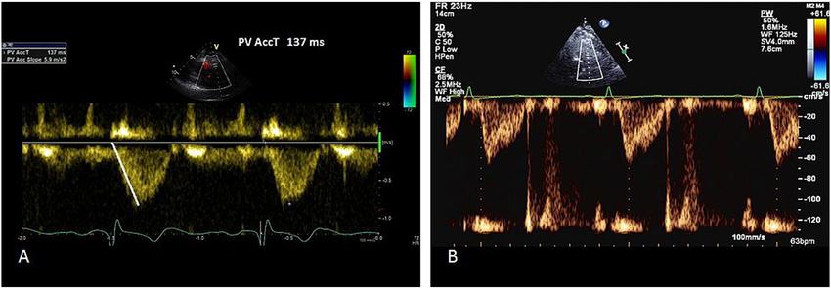
RVOT acceleration time measurement; rapid rise and mid-systolic notching s/o elevated PAP
Normal PW of RVOT – dome shaped
Pulmonary hypertension- rapid rise to peak shorter acceleration time;
mid-systolic notching

Slide 44
Method:
- PW doppler obtained at end expiration
- Just proximal to pulmonary valve
Parasternal short axis view
Maximum sweep speed to increase accuracy

Slide 45
Three regression equation has been described to calculate mPAP
Method described by Mahan et al
Sample volume placed in RVOT
RVOT _{AT} was found to have a linear relation with mPAP.
mPAP = 79-(0.45* RVOT _{AT} )

Slide 46
Method by Kitabatake et al (1983)
Sample volume in RVOT
RVOT _{AT} was found to have curvilinear relation with MPAP
MPAP= 90- (0.62* RVOT _{AT} )

Slide 47
Method by Debastani et al
Sample volume placed in the proximal MPA
This regression equation is used when the RVOT _{AT} was ≤ 120ms
Log₁₀ MPAP = 0.0068(RVOT _{AT} )+2.1

Slide 48
Interpretation: RVOT _{AT} :
Value >130 ms - normal
value < 100ms – PH
MPAP = 90-(0.62 * RVOT _{AT} ), when RVOT _{AT} < 120ms
MPAP = 79- (0.45* RVOT _{AT} ), when RVOT _{AT} >120ms

Slide 50
Pitfall:
1. heart rate <60, >100 may affect the accuracy
2. Measurement of acceleration time might be wrong, with the slope of PW doppler being measured than the acceleration time
* Start from the peak of the envelope and measure time to onset

Slide 51
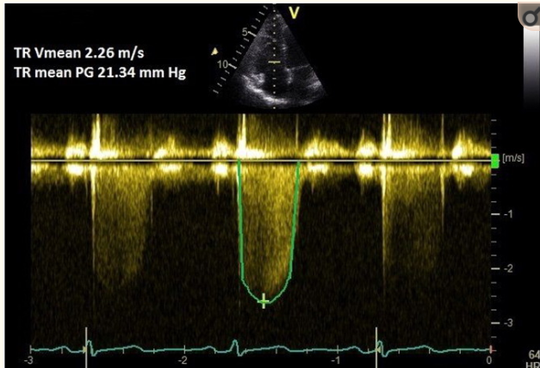
4. mPAP from TR-VTi
CW doppler of TR jet is traced
Mean pressure gradient is measured from TR VTI
mPAP = Mean∆P + RAP

Slide 52
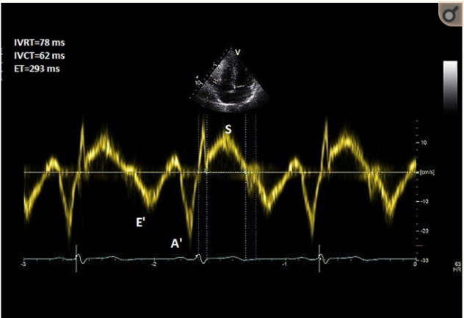
Right ventricular isovolumic relaxation time (_{r}IVRT)
TDI deployed at lateral tricuspid annulus
PW doppler with a 6mm sample window obtained
_{r}IVRT – measured from the offset of S’ wave to onset of E’ wave
Notes:
time from pulmonary valve closure to tricuspid valve opening and can be measured either by pulsed-wave Doppler from tricuspid inflow or with tissue Doppler imaging of the RV free wall.

Slide 53
_{r}IVRT > 75 ms – reliably predicts pulmonary hypertension
_{r}IVRT <40 ms – high negative predictive value for PH
Pitfalls: co-axial TDI may not be possible; incident angle should be less than 15˚
unreliable in HCM, RBBB and RV dysfunction
When heart rate is too high, corrected _{r}IVRT is used

Slide 54
IV. RV FUNCTION assessment

Slide 55
RV fractional area change:
( end-diastolic area - end-systolic area/ end-diastolic area) *100
- Measure of RV systolic function
- Correlate with RV EF by MRI
- Limited by endocardial definition of RV
- Lower reference value- 35%

Slide 56
TEI INDEX and TR measured PASP
Tei index / RIMP/MPI– doppler derived marker of both systolic and diastolic ventricular function
Method: A4C , TDI is deployed on RV free wall and pulse wave doppler is obtained approx 1cm from tricuspid annulus
Tei index = IVRT + IVCT/ET
= TCO-ET/ET
Notes:
RIMP- Right ventricular index of myocardial performance

Slide 57
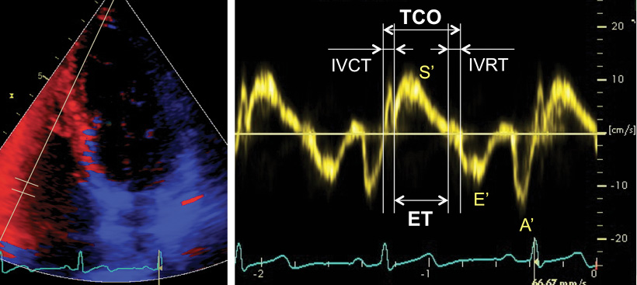
Tei index
>0.4 by PWD
>0.55 by DTI
Notes:
In the pulsed Doppler method, the ET is measured with pulsed Doppler of RVoutflow (time from the onset to the cessation of flow), and the tricuspid (valve) closure-opening time is measured with either pulsed Doppler of the tricuspid inflow (time from the end of the transtricuspid A wave to the beginning of the transtricuspid E wave) or continuous Doppler of the TR jet (time from the onset to the cessation of the jet)

Slide 58
Advantage:
Prognostic indicator
Approach feasible, in the presence or absence of TR
MPI is reproducible
Disadvantage :
Unreliable with differing RR interval as AF
Unreliable with elevated RA pressure (load dependent)

Slide 59
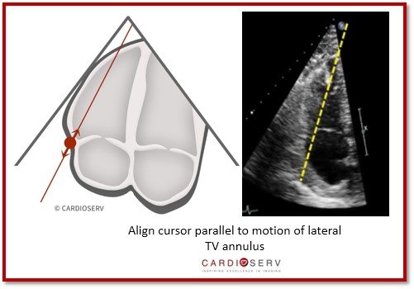
TAPSE
TRICUSPID ANNULAR PLANE SYSTOLC EXCURSION/ TAM – tricuspid annular motion
reflection of the movement of base to apex shortening of the RV in systole
derived from the four-chamber view –M-mode

Slide 60
TAPSE -prognostic indicator in PAH for the assessment of disease severity and response to therapy
<16 – higher mortality
highly load dependent-
-become pseudonormalised in the presence of significant volume loading
-e.g. left-to-right shunting or severe functional tricuspid regurgitation
Notes:
n. As with other regional methods, it assumes that the displacement of the basal and adjacent segments in the apical 4-chamber view is representative of the function of the entire right ventricle, an assumption that is not valid in many disease states or when there are regional RV wall motion abnormalities

Slide 61
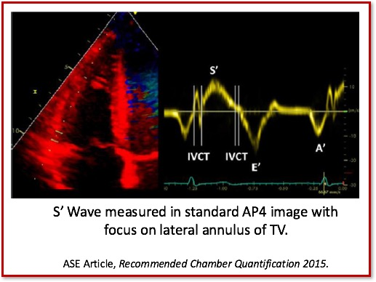
S’ Wave: TDI-Derived Tricuspid Lateral Annular Systolic Velocity
average of three TDI signals from different cardiac cycles
<10 cm/s – impaired RV function
load dependent and may be pseudonormal under conditions of increased volume loading
S' wave velocity requires correction when heart rate is >100 bpm or falls to <70 bpm.

Slide 62
Myocardial accelaration during isovolumic contraction
IVA- isovolumic accelaration
Defined as the peak isovolumic myocardial velocity/ time to peak velocity
Measured by Doppler tissue imaging at the lateral tricuspid annulus
Less load dependent, correlate with severity
Disadvantage: angle dependent, less normative data, affected by age and heart rate.

Slide 64
Not recommended as a screening parameter for RV systolic function
lower reference limit by pulsed-wave Doppler tissue imaging - 2.2 m/s2 , with a broad 95% confidence interval of 1.4 to 3.0

Slide 65
Strain imaging
Strain : Percentage change in myocardial deformation
Strain rate: rate of deformation of myocardium over time
RV strain and strain rate is significantly reduced as a consequence of increased afterload with or without RV contractile dysfunction
LPSS- longitudinal peak systolic strain – >19% indicates RV dysfunction
Notes:
One-dimensional strain is acquired using Doppler tissue imaging and is consequentially angle dependent. It is most reproducible in the apical 4-chamber view, interrogating the basal, mid, and, to a lesser degree, apical segments of the RV free wall. As a result, one is limited to mostly longitudinal strain
To calculate strain, high frame rates are required, ideally $150. o align the segment in the center of the sector to avoid errors due to the angle dependence of Doppler. A maximum tolerance of 10 to 15 off the axis of contraction is recommended.130 Imaging is in color-coded tissue Doppler mode, and $3 beats are acquired with suspended respiration. Values for strain and SR are then derived offline on the system or workstation using equipment-specific algorithms by placing sample volume(s) or regions of interest of varying sizes in the mid portion of the segment(s

Slide 66
M-mode echocardiography
Three abnormalities of the pulmonary valve :
Absent or diminished ‘a’ wave
Midsystolic notching or closure of the pulmonary valve
Increased right ventricular pre-ejection period to ejection time (RVPEP/RVET) ratio

Slide 67
‘a’ – depth of the posterior deflection of pulmonary valve immediately following atrial contraction; correlates with the peak pressure gradient across pulmonary valve; normally measures 2-7mm
Limitation: 1. atrial fibrillation
2. no correlation between a wave amplitude and actual PAP
3. normalisation of ‘a’ wave in those with coexistant RV failure
Notes:
Normally theres a minimal difference between the RVEDP & PAEDP. Therefore a small increase in I RVEDP will be transmitted to the PV resulting I a defelcetion. In PH, the increase in PAEDP is much greater than RVEDP.

Slide 68
Mid-systolic notching – produce characteristic ‘W’ shaped pattern

Slide 69
Increased RVPEP/RVET
RVPEP: Q wave of ECG to the onset of valve opening
RVET: interval in which the valve remain open
(b – e points)
Both the intervals are affected by heart
RVET- increases with advancing age
The ratio – not significantly affected by age/heart rate
In PH, RVET decreases, RVPEP lengthens, with increase in ratio

Slide 70
PAEDP | RVPEP/RVET
Normal (PAEDP- 10-15 mm Hg) | ≤ 0.30
PH (PAEDP>20mm Hg) | >0.35
‘gray area’ | 0.3-0.35
Limitation:
Difficulty In recording opening and closing of PV
Small error may lead to large error in calculation
Conduction defect like RBBB, increases RVPEP

Slide 71
ECHO DIFFERENTIATION OF PAH vs PVH

Slide 72
PULMONARY HYPERTENSION FORMULAE
PASP = 4 (TV max)² + RAP
mPAP = 4 (PR early vel)² + RAP
= 79-(0.45* RVOT _{AT} ) (AT>120ms)
= 90- (0.62* RVOT _{AT} ) (AT<120ms)
= 2/3 (PADP) + 1/3 (PASP)
3. PVR = (PASP/RVOT VTI) + 3 if notch present, 0 if no notch

Slide 73
MCQ
Not a measure of RV dysfunction:
S’ velocity >10
Tei index >0.4 by DPI
TAPSE <16
RV FAC >0.4

Slide 74
Mpap can be calculated from all except:
Tr peak velocity
Pr end diastolic velocity
TR VTI
RVOT -AT

Slide 75
Identify the segments

Slide 76
Assuming the RAP is 8 mm Hg, calculate the PASP, mPAP

